Slide 1
The 7th Week…
Peter Horgas

Slide 2
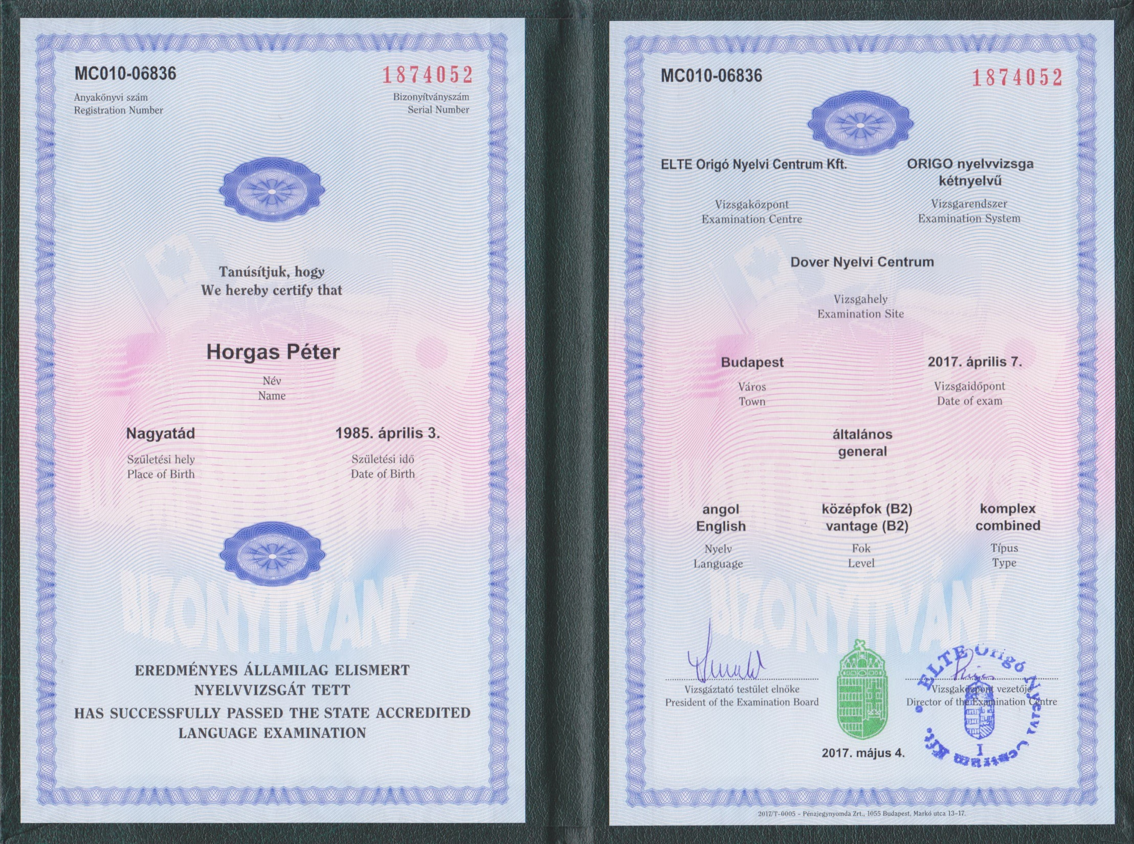

Slide 3
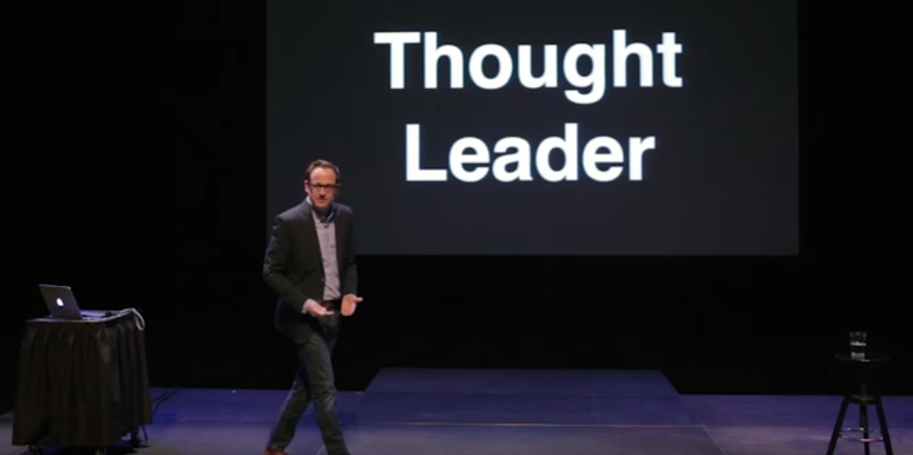
On Wednesday…

Slide 4
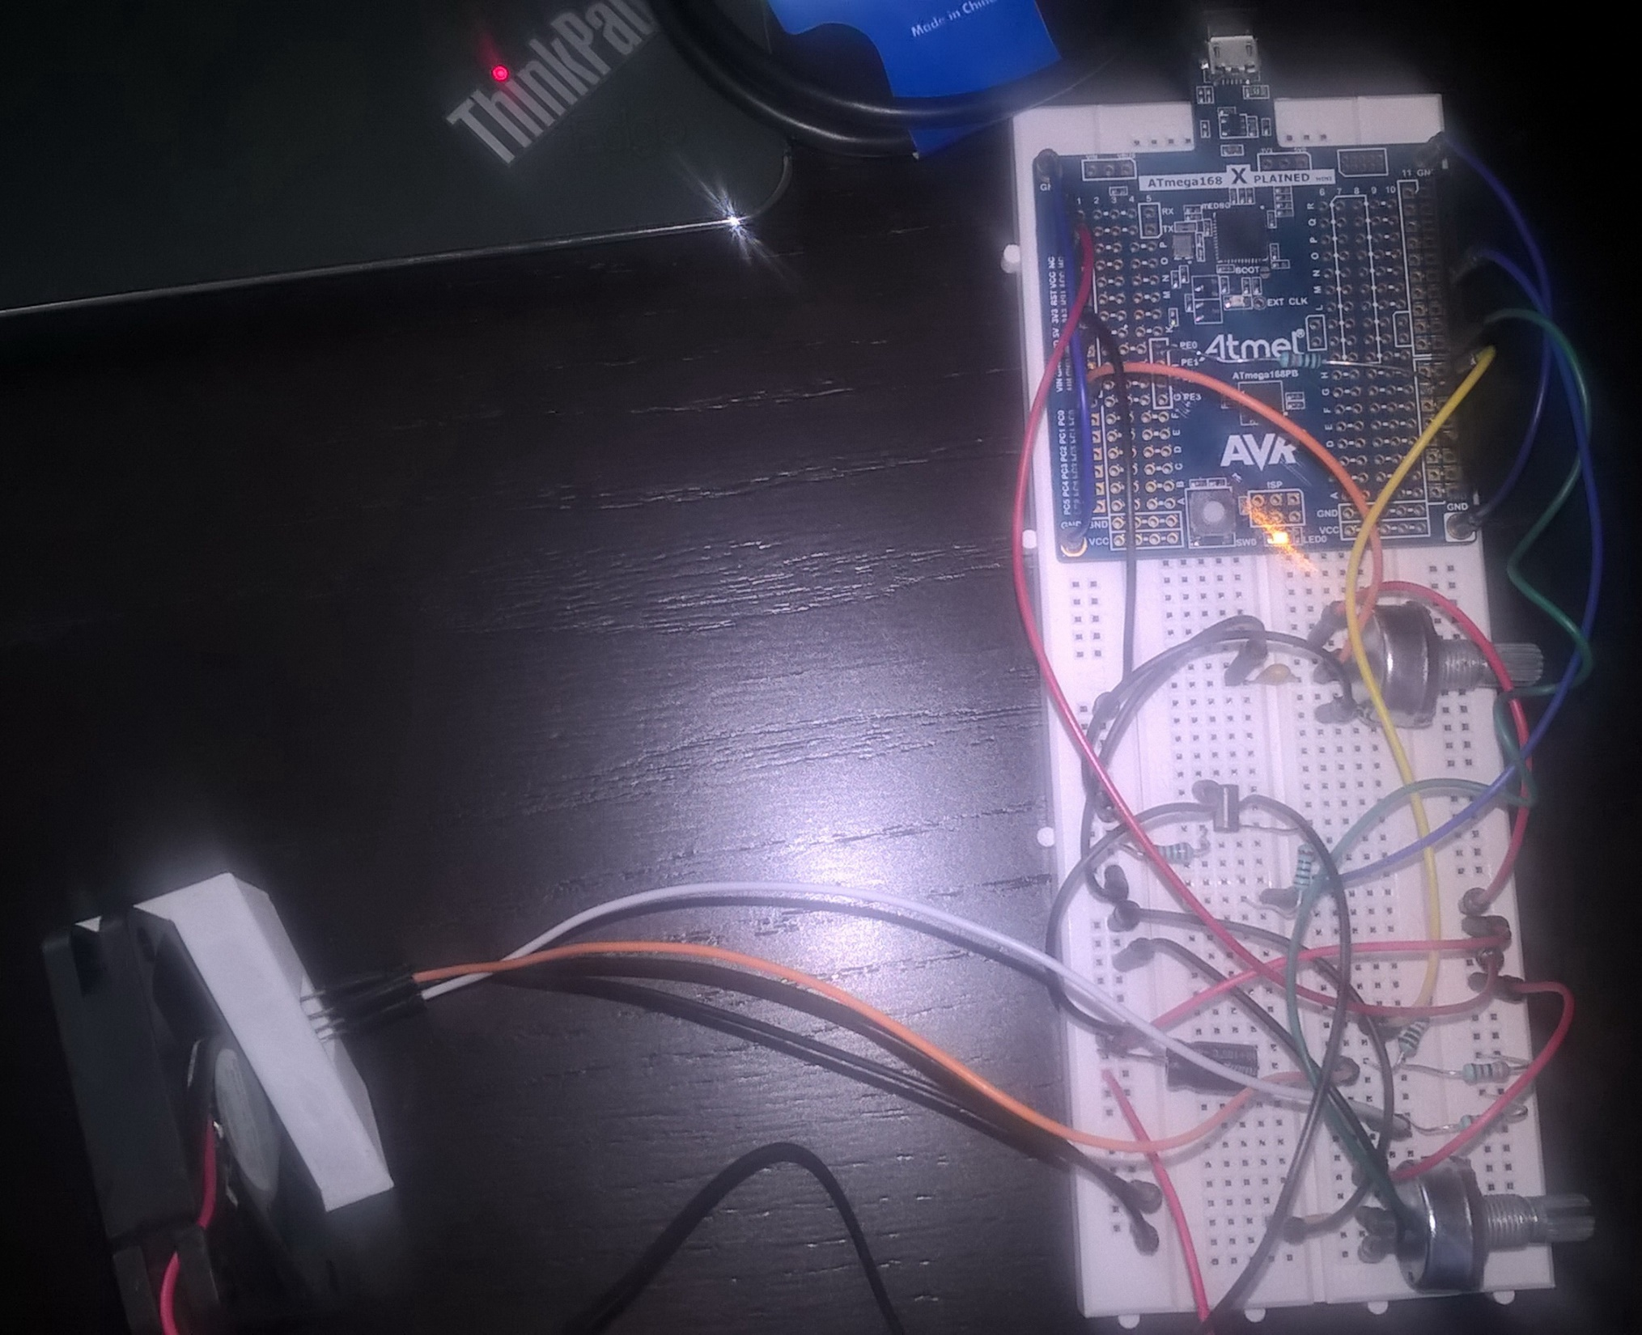
The whole thing

Slide 5
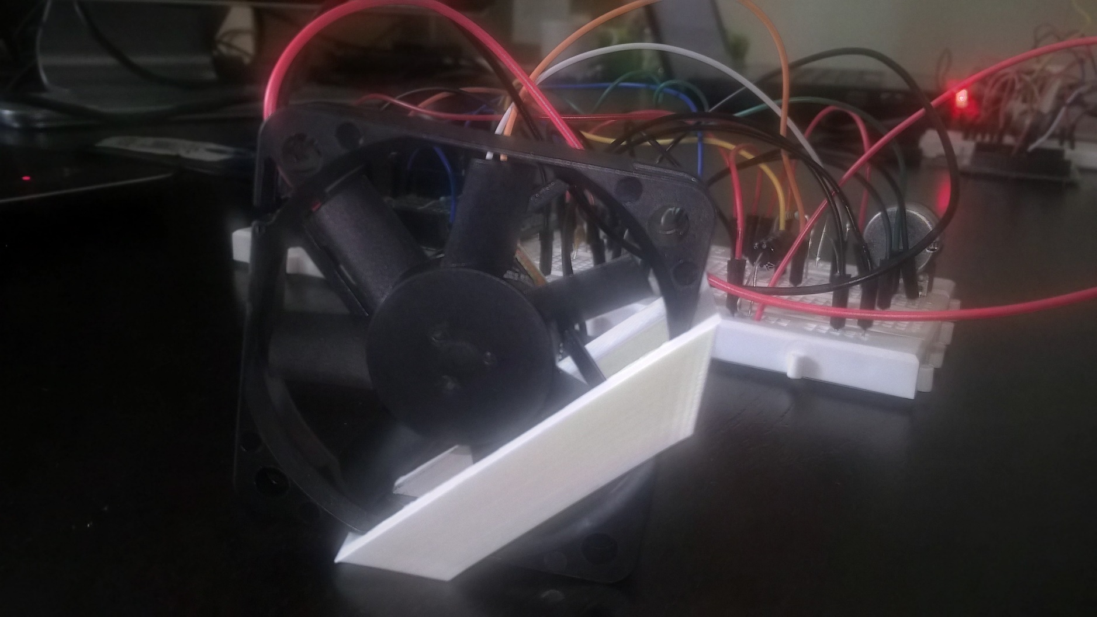
The details:

Slide 6
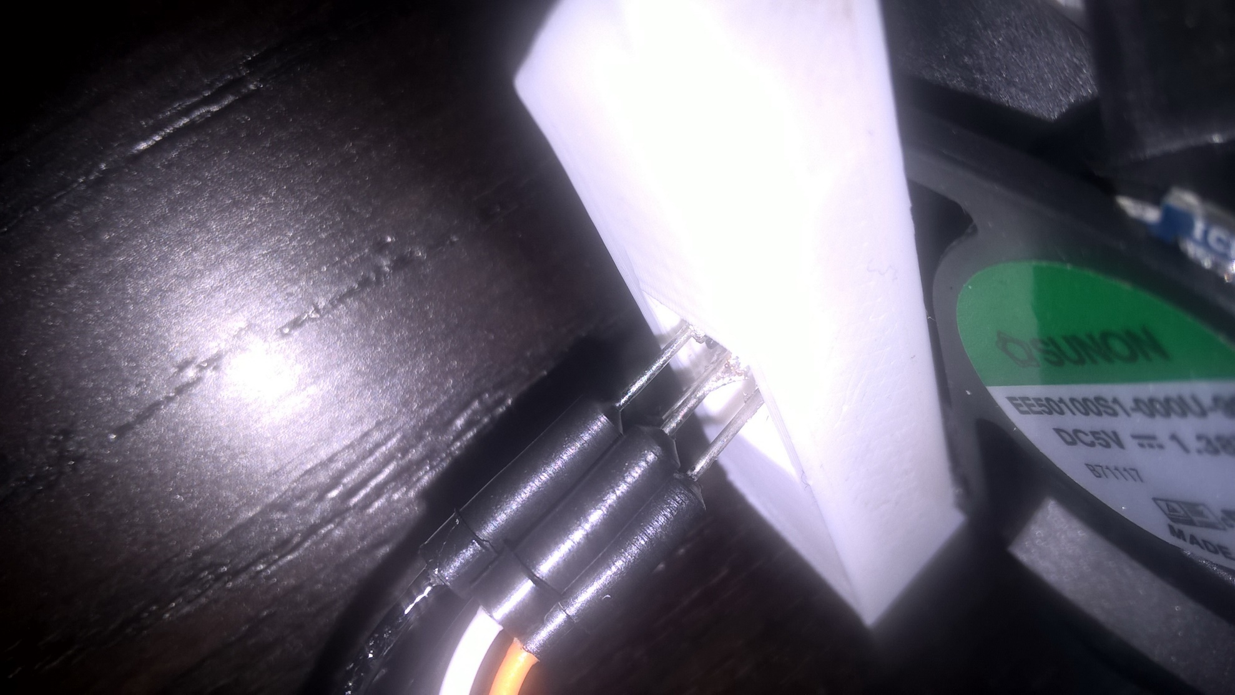
3D printed sensor holder

Slide 7
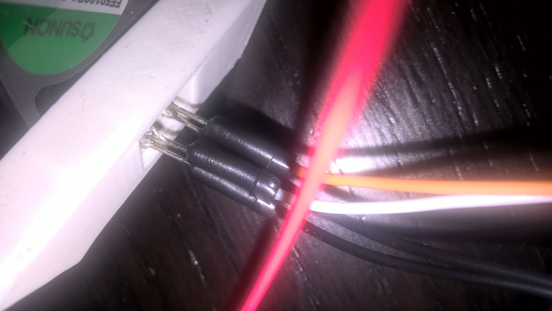

Slide 8
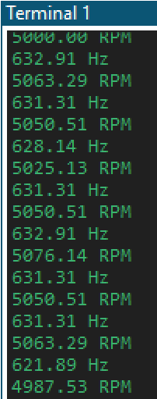
Rpm of the Fan
:)

